Slide 1
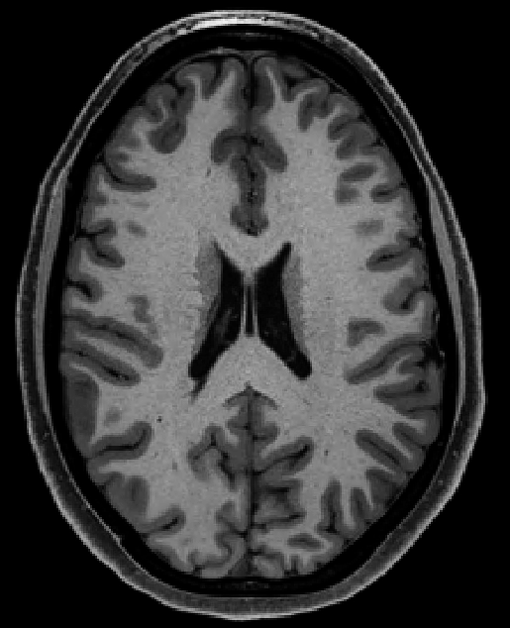

lateral ventricle (CSF)
WM
sulcus
gyrus
cortical
GM
CSF
subcortical GM structure
cranium

Slide 2
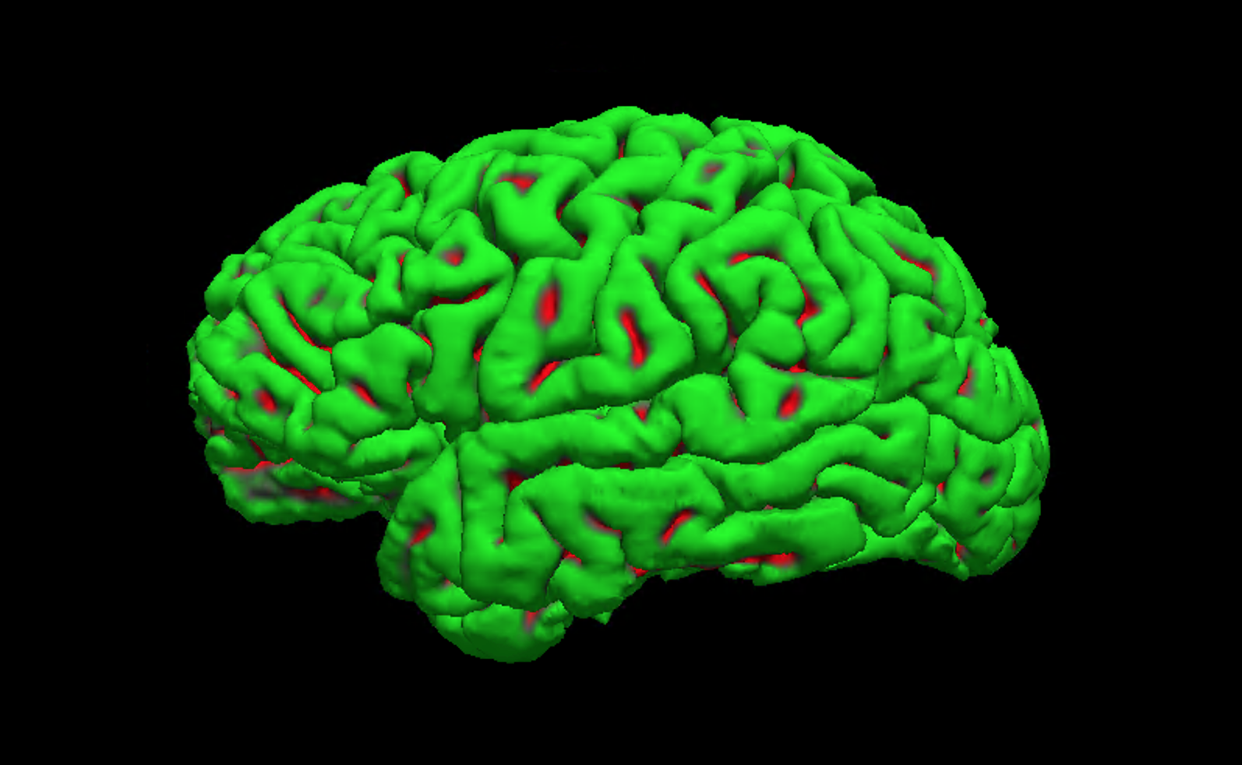
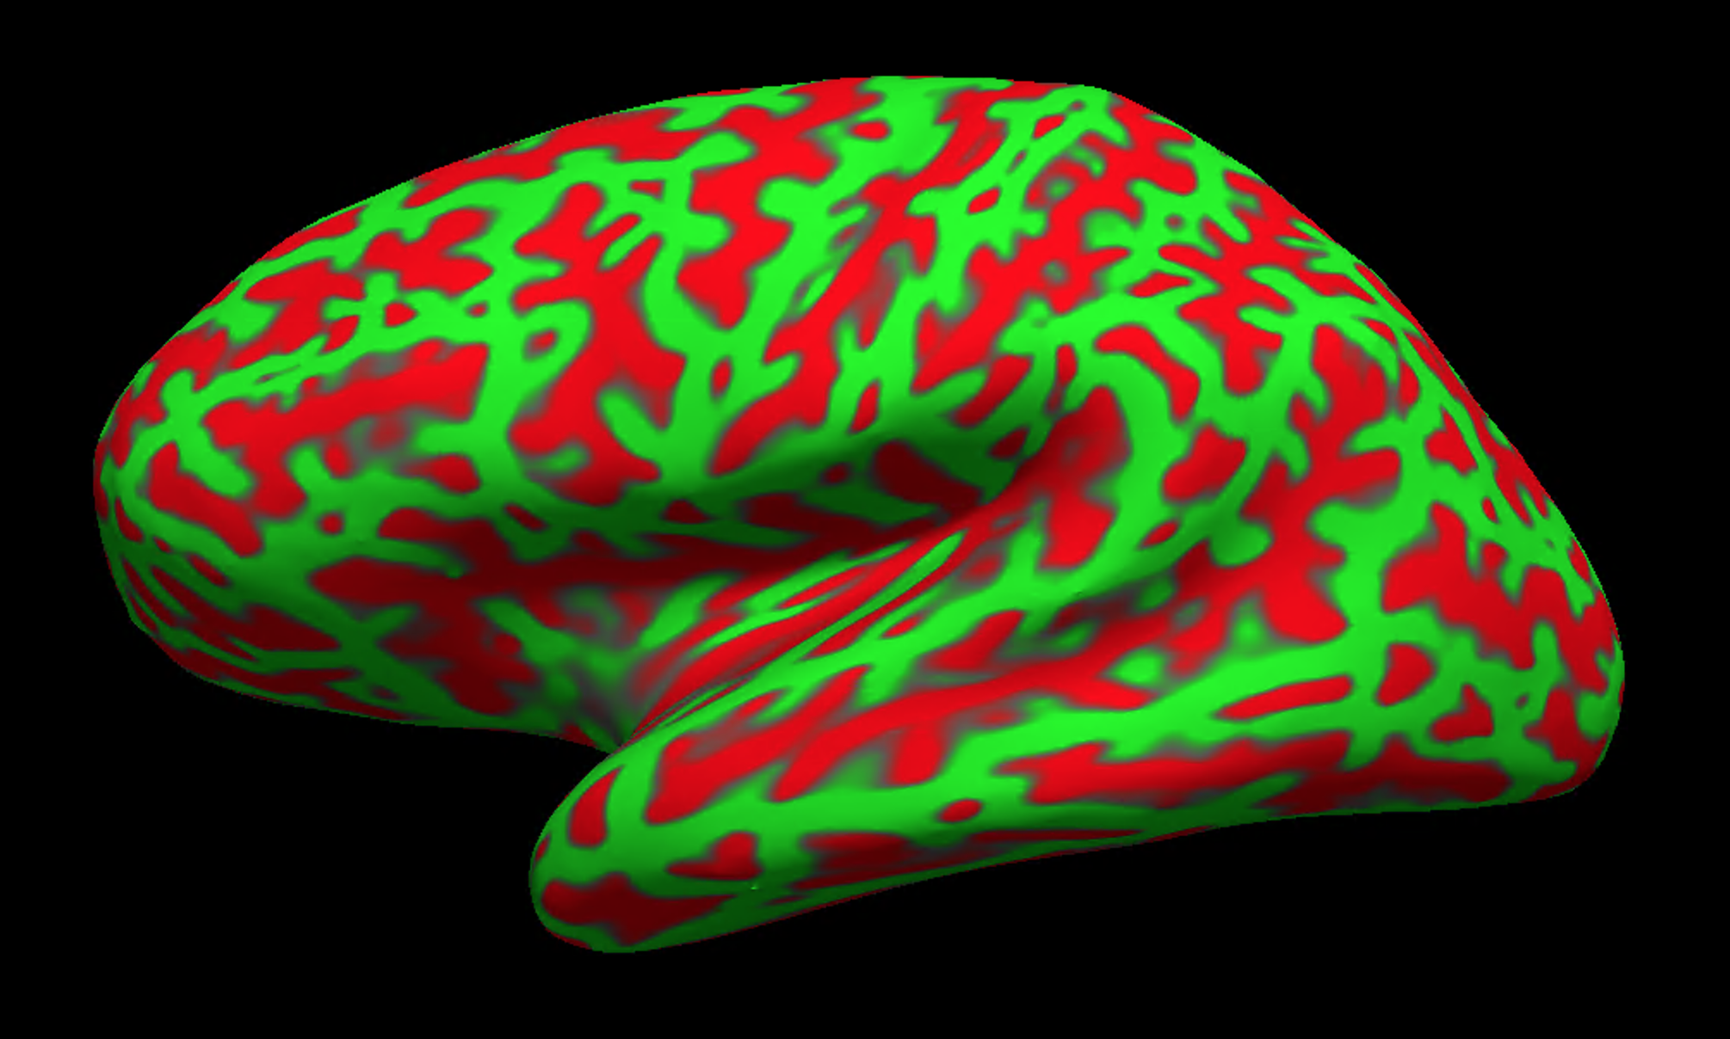
sulcus
gyrus
pial, native
pial, inflated

Slide 3
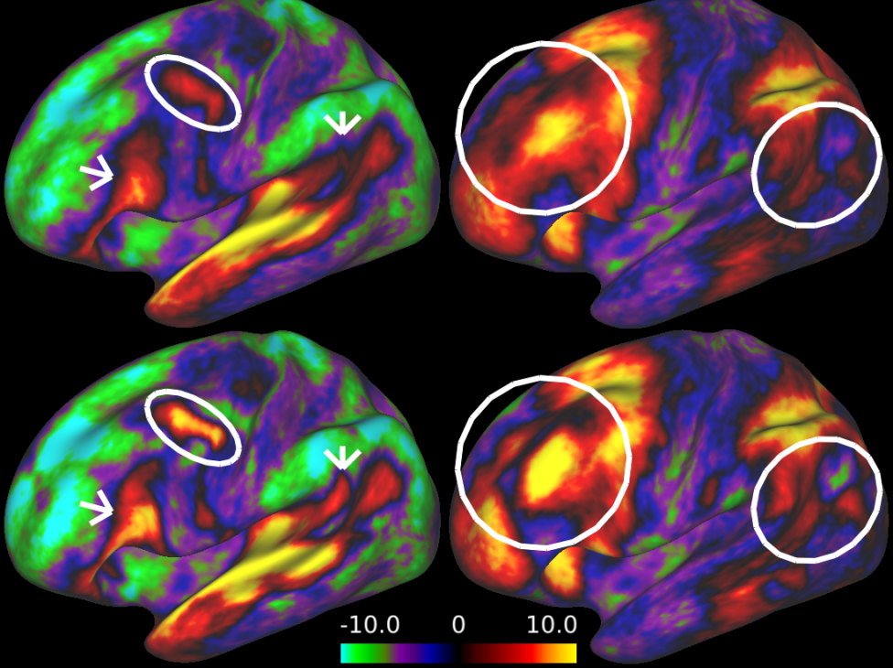
task A
task B
folding
folding + areal

